Slide 1
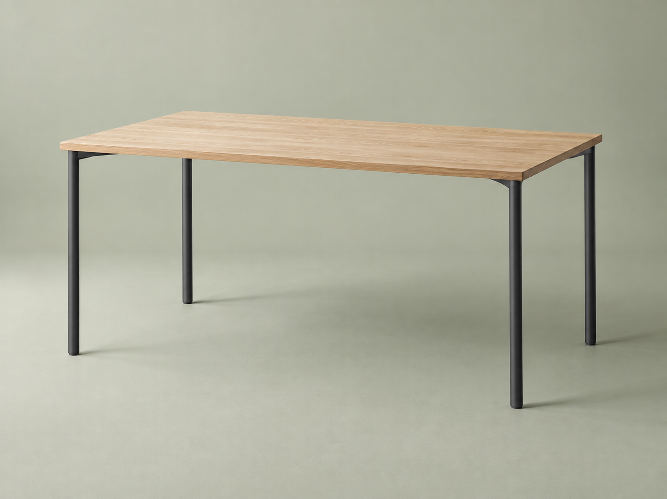
tesylate
EXAMPLE PROJECT PROPOSAL / Q-0141
Riverside
workspace.
A better place to do your best work.
Prepared for Ashford Interiors
Sample records · illustrative document

Slide 2
tesylate
THE WORKSPACE / 01
Space for the whole team.
STUDIO COLLECTION
Studio desk
Oak finish · graphite legs
1,400 × 700 mm
6 desks × £480
£2,880
Total excluding VAT
Illustrative document using sample records. This is not an offer for sale.

